Slide 1

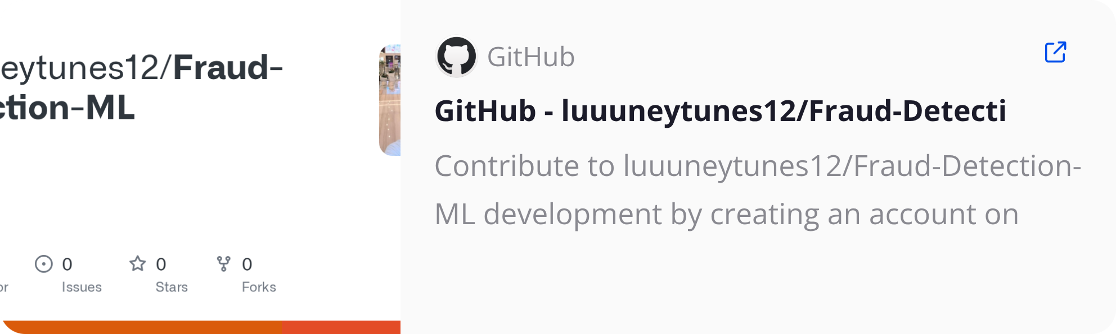
Fraud Detection: A Hybrid ML Approach
Leveraging LightGBM, PyTorch MLP, and Stacking Ensembles for Enhanced Accuracy

Slide 2

The Billion-Dollar Problem of Credit Card Fraud
High False Positive Rates
Traditional rule-based systems decline legitimate transactions, leading to customer frustration, churn, and revenue loss for banks.
Low Fraud Detection
Rule-based systems detect only ~60% of fraud. Criminals adapt faster, leaving 40% of fraudulent transactions undetected and causing significant financial losses for institutions.

Slide 3

Maximizing Fraud Detection with Machine Learning
Given the complex, high-velocity transactional data, Machine Learning models are essential.
Maximize fraud detection (recall) to minimize financial losses and protect customers.
Minimize false alarms to reduce customer friction and maintain transaction flow.
Address extreme class imbalance common in fraud datasets, where fraudulent transactions are rare.

Slide 4



Project Objectives: Optimizing for F2-Score
Primary Goal: Maximize F2-Score
The F2-score prioritizes recall (fraud detection) twice as much as precision, aligning with the critical need to drastically reduce costly false negatives (undetected fraud).
Secondary Goal: Maintain Precision
While recall is paramount, precision remains crucial to prevent excessive false alarms, ensuring a smooth customer experience.

Slide 5

My Solution Blueprint: A Hybrid Ensemble Approach
Combining traditional ML with neural networks to capture complex fraud patterns.
Transaction Features
Input data for models
Fraud / Legit
Hybrid Ensemble Blueprint
LightGBM Pipeline
Final prediction output
HyperparameterSwept
StackingClassifier
PyTorch MLP
Logistic Regression Meta Learner
Optuna Tuned

Slide 6

Model Components: Strengths and Tuning
1
2
LightGBM Pipeline
PyTorch MLP Neural Network
Tree-based model excelling at feature interactions, incorporated with extensive hyperparameter sweeping.
Deep learning model capable of capturing non-linear patterns, tuned with Optuna to prevent overfitting.
3
Stacking Classifier (Meta-Learner)
Combines the strengths of base models, allowing for more robust fraud detection and improved overall performance.

Slide 7
Performance Evaluation: Stacking Classifier Dominates
Model
Precision
Recall
F1
F2
PR-AUC
Business Outcome
Baseline Dummy Classifier
0%
0%
0%
0%
50%
Catches no fraud
LightGBM x SMOTE
70%
80%
75%
77%
81%
Good recall, too many false alarms
PyTorch MLP
68%
81%
74%
78%
80%
Highest recall, but more false alarms
Stacking Classifier
87%
78%
82%
80%
83%
Acceptable High Recall, Extremely High Precision (Maximized F2)
The Stacking Classifier significantly improves precision by +17% over individual models while maintaining strong recall, crucial for minimizing customer friction.

Slide 8

Quantifiable Business Impact
Reduced Revenue Leakage
Our models detect ~80% of fraudulent cases, a significant leap from the 0% of a dummy baseline, directly preventing financial losses.
Optimized for Costly False Negatives
The Stacking Classifier, optimized with F2-score (83%), consistently catches more fraud in critical scenarios, ensuring high detection even under data imbalance.
Enhanced Customer Experience
High precision (87%) with acceptable recall drastically reduces false alarms, leading to happier customers and lower churn rates.

Slide 9

Key Learning Outcomes
Reproducible Code Organization
Efficient Package Management
Attempted modular code organization for reproducibility via OOP.
Working with uv for fast package installation compared to pip.
Imbalanced Data Handling
Robust Model Evaluation
Data preprocessing and handling imbalanced datasets with SMOTE oversampling.
Implementing Stratified K-Fold Cross Validation for robust model evaluation.
Advanced Hyperparameter Tuning
Hybrid Model Development
Visualing model training with WandB, conduct hyperparameter sweeping and applying Bayesian optimization via Optuna.
Building and training LightGBM, PyTorch Neural Networks, and a stacking ensemble.

Slide 10







Technology Stack

Slide 11
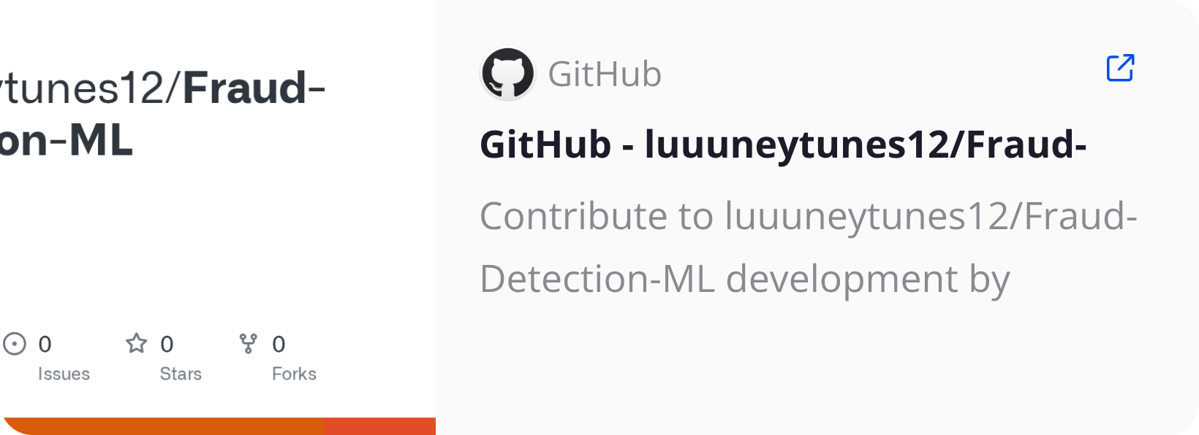



Thank You!
View project source code & details here:
Contact Information:
Email: wlcheng.2023@scis.smu.edu.sg
Phone: +65 9683 5839
Connect With Me:

